Slide 1
KSC6103 Data structure & Algorithm
Topic 8: Sorting

Slide 2
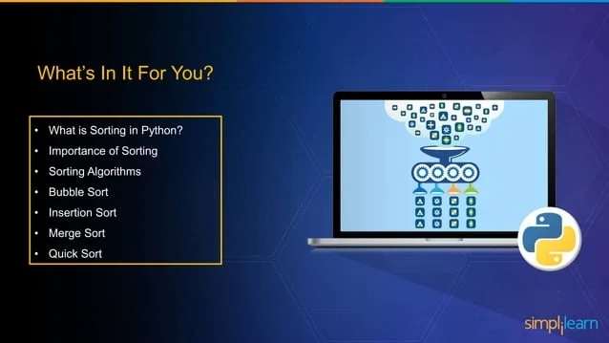

Slide 3
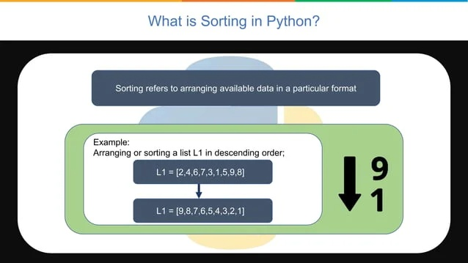

Slide 4
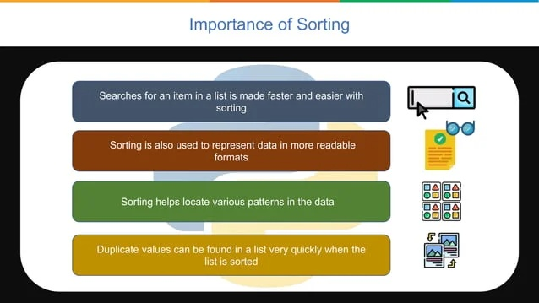

Slide 5
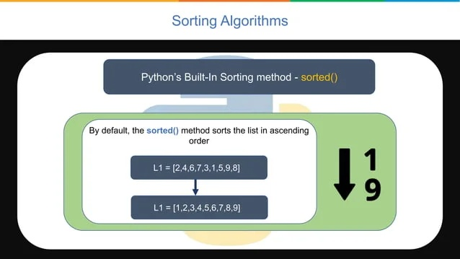

Slide 6
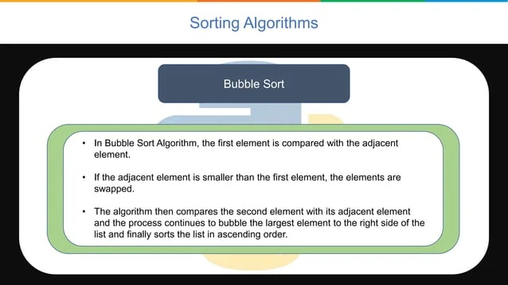

Slide 7
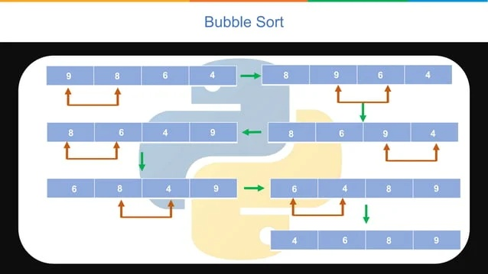

Slide 8
PSEUDOCODE
In first cycle,
Start by comparing 1st and 2nd element and swap if 1st element is greater.
After that do the same for 2nd and 3rd element.
At the end of cycle you will get max element at the end of list.
Now do the same in all subsequent cycles.
Perform this for (number of elements – 1) times.
You will get sorted list.

Slide 9
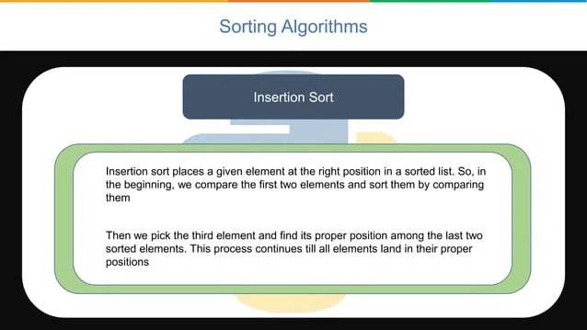

Slide 10
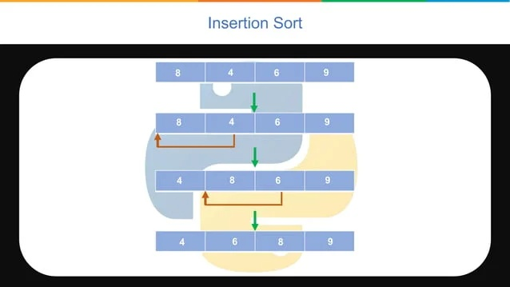

Slide 11
PSEUDOCODE
In first cycle, Get 2nd element and order it according to 1st element. i.e, if smaller place it before 1st element.
In second cycle, get 3rd element and order it according to 1st and 2nd element. i.e, place them in ascending order.
Now do the same in all subsequent cycles.
Perform such (number of elements – 1) cycles.
You will get sorted list.

Slide 12
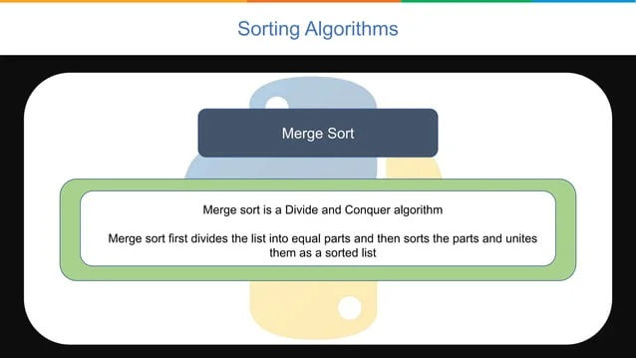

Slide 13
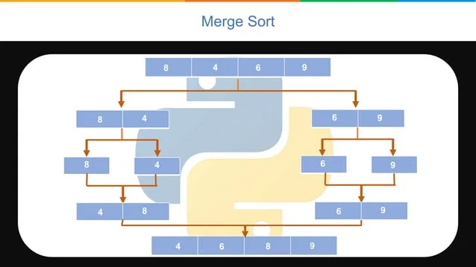

Slide 14
PSEUDOCODE
For an array of length ‘N’, split it into two halves(left and right subarrays) as evenly as possible.
Now, let’s take the left subarray and repeat the step 1 till we have sub arrays of length 1.
Start to merge the elements of the subarrays in the order they were split with the smallest digit placed at the start.
Repeat step 3 till the whole left array is sorted and merged.
Repeat steps 2, 3 and 4 for the right subarray.
Now take the two sorted subarrays and pick the first elements or both the subarrays, compare them and place the smallest one at the start.
Repeat step 6 for the proceeding elements.

Slide 15
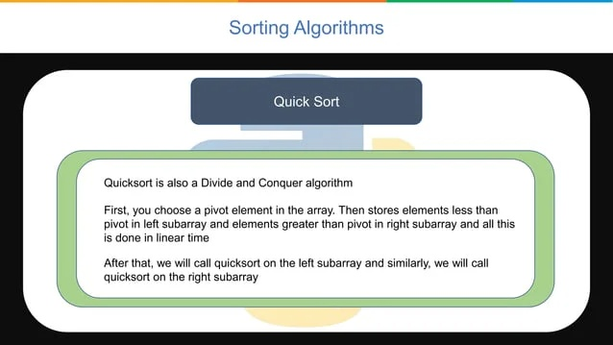

Slide 16
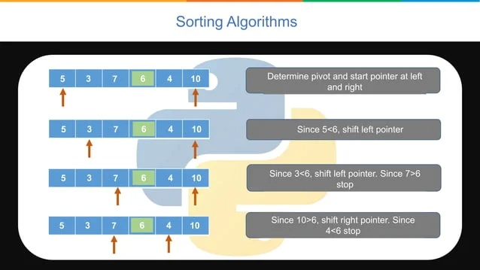

Slide 17
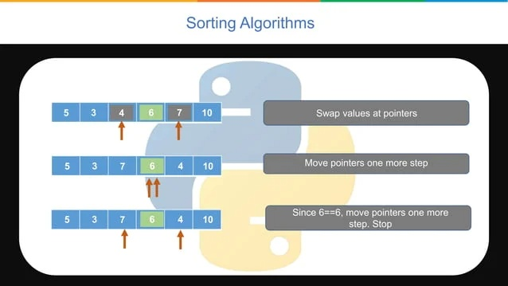

Slide 18
PSEUDOCODE
In an array A of length ‘N’, take the last element as pivot.
Now let i be (A[0] – 1) and j be the A[N-1].
To find the sorted position of the pivot, start incrementing i till you find an element greater than the pivot.
At the same time start decrementing j till you find an element lesser than or equal to the pivot.
Swap the elements present at i and j.
Repeat steps 3 and 4 until i has an element greater than j.
Swap the pivot with the element present at j.
Repeat the above steps for the left and right side of the pivot and you will have a sorted array at the end.

